Slide 1
Examples:
The examples describe functions that are easily overlooked in the technical assessments in previous seasons. Participating teams can improve the display of these functions based on the examples.
General requirements for video filming:
1. The Armor Module graphs/backdrop for the technical assessment should be demonstrated.
2. For functions with specific numerical requirements, corresponding data, such as slope and distance, should be provided.
3. For functions involving strikes/hit rate, the supporting data should be displayed (using carbon paper or subtitle in the video).
4. The video should be filmed in one take. Editing is not allowed.

Slide 2
Robot Building Specifications Demonstration

Slide 3
Display the mounting bracket for the Positioning System Module and deformation of the bracket when a force of 40 N is applied on it

Slide 4
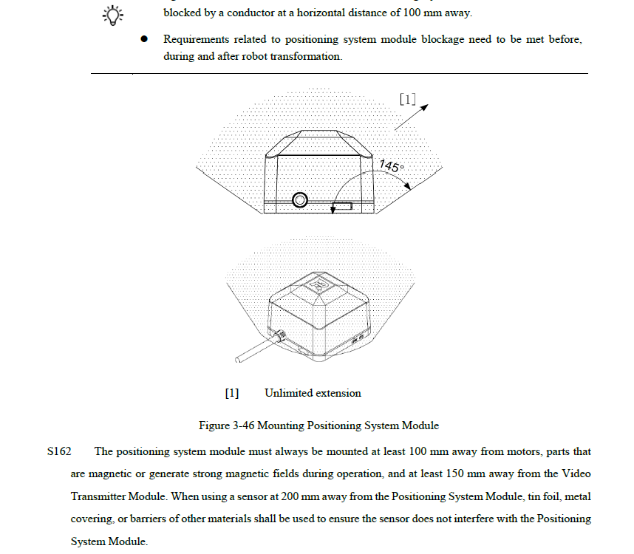
Notes:
Requirements:
1. The graph must be demonstrated. Provide a video if you have the physical object. The module locations must be clearly marked in the video and graph.
2. Graph requirements:
① Take the four outermost edges of the bottom of the Positioning System Module as sides, and extend at least 200 mm in the 145° direction above the surface formed by the four edges.
② Mark in the graph the distances between the Positioning System Module and the relevant components listed in S160, Robot Building Specifications Manual V1.0.
3. Video requirements (the physical object, if any, should be displayed):
① Demonstrate the reading after the force gauge (or other instruments) applies force perpendicular to the mounting bracket and the real-time change of the mounting bracket.

Slide 5
Display the mounting area of the Speed Monitor Module (mounted properly as per the mounting specifications)

Slide 6
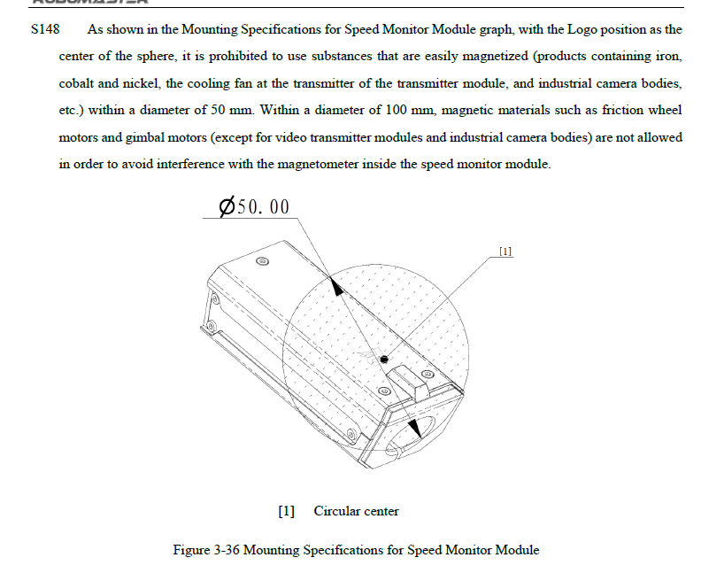
Video page
Notes:
Requirements:
1. The graph must be demonstrated. Provide a video if you have the physical object. The module locations must be clearly marked in the video and graph.
2. For the graph, draw transparent spheres with diameters of 50 mm and 100 mm, respectively. The center of the spheres is at the position of the Speed Monitor Module's logo.
3. For the video, display the distances between the Speed Monitor Module and the relevant components (measured using a tape measure) listed in S147, Robot Building Specifications Manual V1.0.

Slide 7
Display the mounting location of a fluorescent energy-charging device (mounted properly as per the mounting specifications)

Slide 8
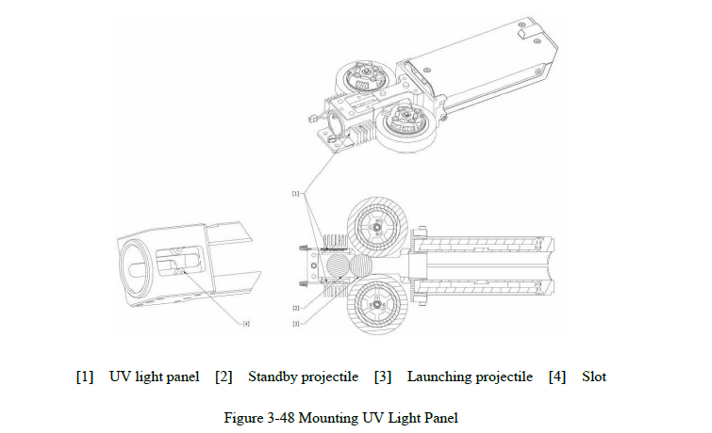
Video page
Notes:
Requirements:
1. The graph must be demonstrated. Provide a video if you have the physical object. The module locations must be clearly marked in the video and graph.
2. In the graph, demonstrate the top view of the 17 mm fluorescent energy-charging device, standby projectile, and launching projectile.
3. In the video, demonstrate the positions of the fluorescent energy-charging device, standby projectile, and launching projectile.

Slide 9
Display the mounting of other Referee System modules or the mounting location reserved for the Referee System

Slide 10
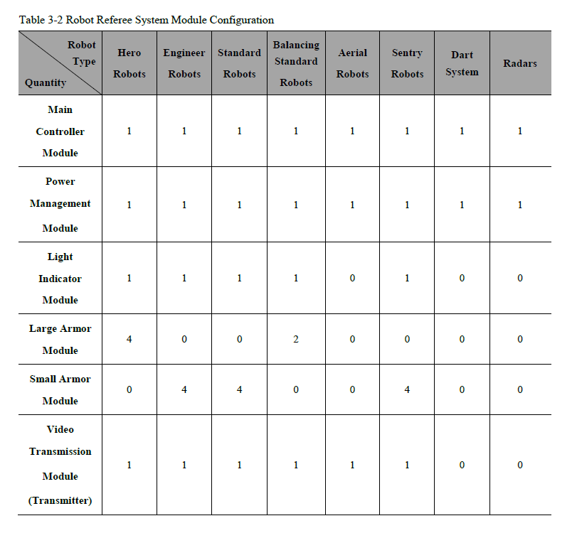
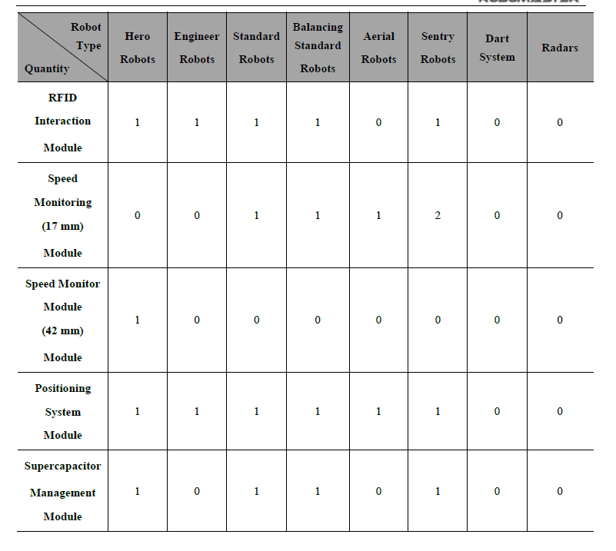
Notes:
Requirements:
1. Graphs must be demonstrated. Provide videos if you have the physical objects. The module locations must be clearly marked in the videos or graphs.
2. Display the mounting locations of all Referee System modules of the corresponding robots according to the table of Referee System Configuration.

Slide 11
Robot Function Demonstration

Slide 12
Video page
Notes:
In this example, the missing information includes: The slope in degrees, which is 15° (a common problem);
According to the standards of the 2023 Season, the displayed information about this function must include: ① The slope in degrees, which is 15°; ② The power consumption data during robot slope climbing; ③ The backdrop/Armor Module for the technical assessment.

Slide 13
Standard - Launch 50 rounds of projectiles continuously from the magazine to attack a subject with the size of a Large Armor Module at 5 meters away, calculate the hit rate, and display relevant evidentiary materials (such as copies made by using carbon paper)

Slide 14
Video page
Notes:
In this example, the missing information includes: The 5-meter distance (a common problem), and supporting materials for the hit rate data (a common problem: The assessment process will not check if each projectile hits. We recommend that participating teams prepare supporting materials for hit rate statistics in advance.)
According to the standards of the 2023 Season, the displayed information about this function must include: ① The 5-meter distance; ② The supporting materials for hit rate; ③ The robot hitting process; ④The backdrop/Armor Module for the technical assessment.

Slide 15
Standard - Automatically identify and pan or rotate along an Armor Module, launch 30 rounds of projectiles continuously to strike the Armor Module, calculate the hit rate, and display relevant evidentiary materials (such as copies made by using carbon paper)

Slide 16
Video page
Notes:
A good example (by last year's standards): The backdrop and the following armor plate are clearly demonstrated. This year, please conduct a hitting demonstration with the following armor plate, and display the supporting materials (such as copies made by using carbon paper) showing the hitting rate.
According to the standards of the 2023 Season, the displayed information about this function must include: ① The following armor plate; ② The backdrop/Armor Module for the technical assessment.

Slide 17
Standard - Simulate activating a Small Power Rune for 5 consecutive times: Strike a rotating Small Power Rune at 8 meters away and calculate the number of hits on the Power Rune Armor Module (if no Small Power Rune is available, projection can be used instead)

Slide 18
Video page
Notes:
A good example (by 2023's standards): The technical assessment backdrop, and the distance and activation status are displayed. (If projections are used, the number of hits on the Power Rune Armor Module can be displayed in subtitles after each strike.) Based on last year's standard, striking 5 times in a row must be performed this year.
According to the standards of the 2023 Season, the displayed information about this function must include: ① The distance between the robot and the Power Rune; ② The backdrop/Armor Module for the technical assessment; ③ The process of the robot hitting the Power Rune and activation status.

Slide 19
Standard - Steadily pass over a Launch Ramp for 3 consecutive times (display proof of a 17° slope of 350 mm in height and a landing point greater than 650 mm)

Slide 20
Video page
Notes:
In this example, the missing information includes (by 2023's standards): The size of the Launch Ramp and the landing point (a common problem)
According to the standards of the 2023 Season, the displayed information about this function must include: ① The size of the Launch Ramp; ② The landing point (horizontal distance traveled); ③ The complete process of passing over the Launch Ramp; ④ The backdrop/Armor Module for the technical assessment

Slide 21
Hero - Simulate a lob shot from a Hero Sniper Point: Launch 15 rounds of 42 mm projectiles continuously to strike a subject with a diameter less than 450 mm at over 20 meters away, calculate the hit rate, and display relevant evidentiary materials (such as copies made by using carbon paper)

Slide 22
Video page
Notes:
A good example (by 2023's standards): The backdrop for the technical assessment is displayed. During the shooting process, the robot and the subject are in the same frame (you can also use two cameras and sync the clips in one sequence). The video is filmed in one shot. Subtitles contain statistical data. The only drawback is the lack of relevant supporting materials (such as copies made by using carbon paper).

